Slide 1









Meowies
Tune into purrfection

Slide 2
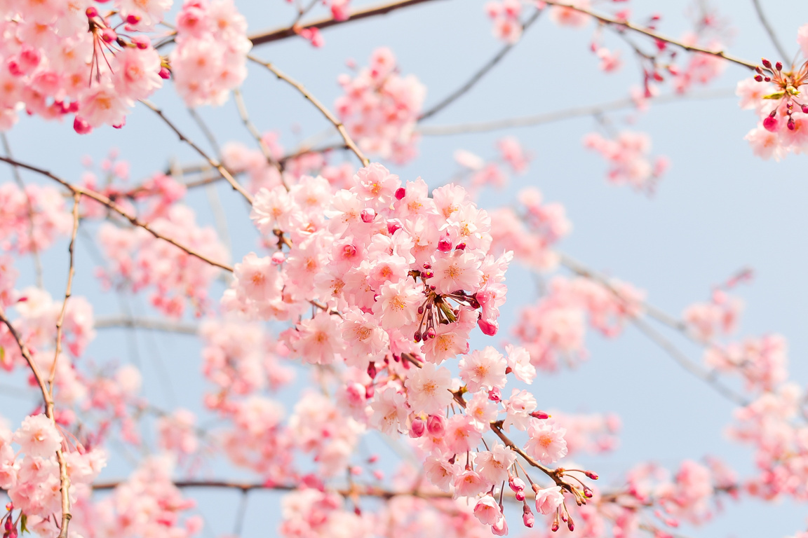
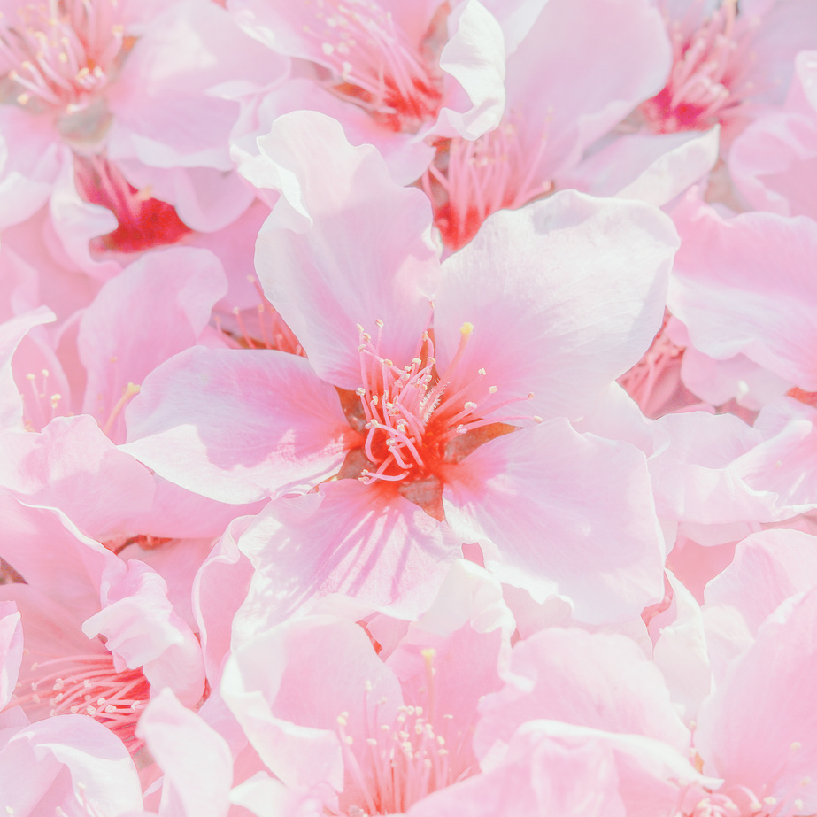
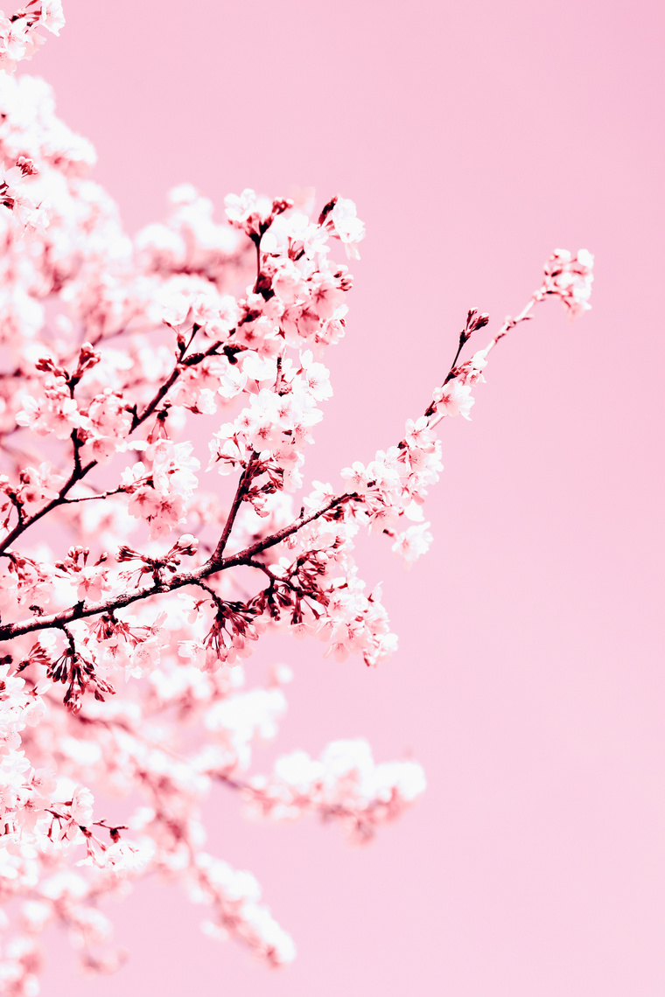
our team
Meha and Fatima A
Shermin and Rida
Krishikaa and Shaira

Slide 3
What is it all about
Meowies is all about the musical experience whilst enjoying the design too. Inspired by everything that we like around us, Meowies only provides the best experience

Slide 4
Inspiration
Many things have inspired us including this school. WHSG play a significant role in this branding because of its design and material too. Our school’s uniform patterns and colours help us design Meowies and bring it to life. Meowies, as you can tell by it’s name is a brand for those cat lovers too but soon, a dog lovers side will be opening

Slide 5
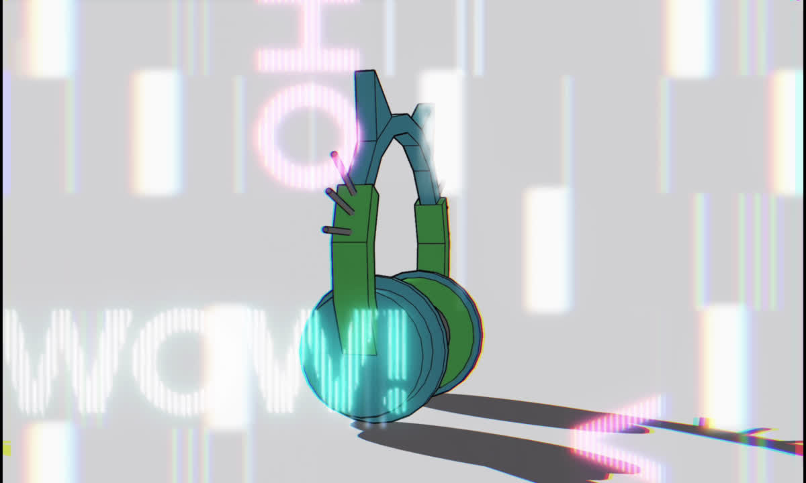
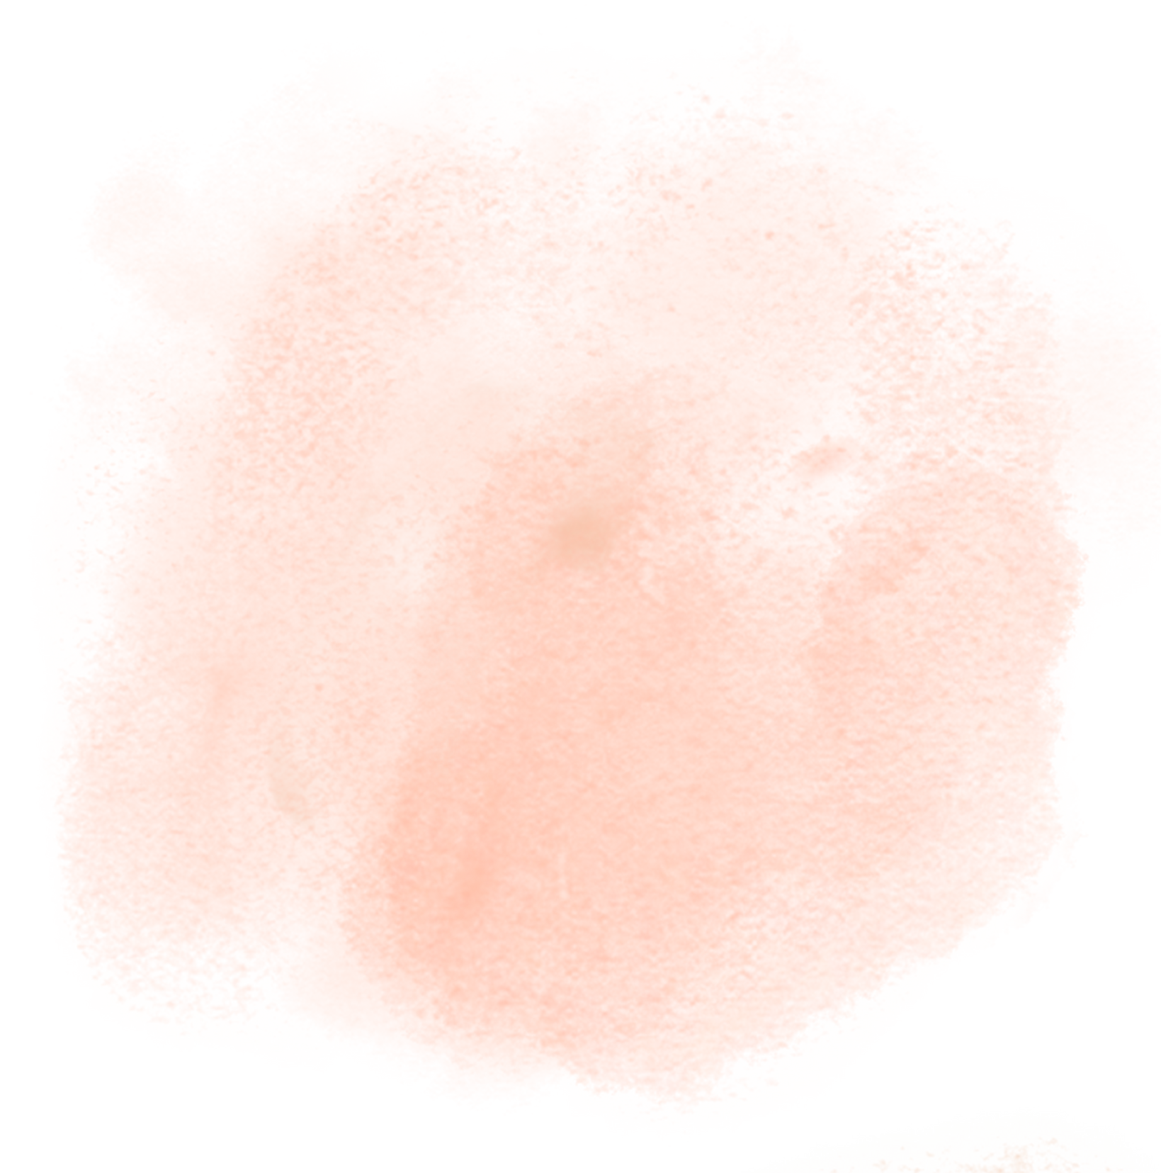
designs

Slide 6
Goals
1.
We hope to achieve many this for this brand including to win this apprenticeship project as a team.
2.
We also hope to achieve a new part into this brand, as discussed earlier, a dog section to this brand

Slide 7
Conclusion
We hope Meowies has inspired you and Lord Sugar to take us for this classes' winner. Our design, inspiration and everything else is enough to wow you all!!

Slide 8
QnA
Session

Slide 9
Thank
You

